Slide 1
The Decorator Pattern

Slide 3
What if the milk price goes up?
What design principles are violated?
What if a new topping is added?

Slide 4
double cost(){
double total = 0;
if (hasMilk()) total += .50;
if (hasSoy()) total += .65;
… …
return total;
}
double cost(){
return super.cost() + 1.50;
}

Slide 5
public class Beverage {
public double cost(){
double total=0;
if (hasMilk())
total += .50;
if (hasSoy())
total += .65;
… …
return total;
}
}
public class DarkRoast extends Beverage {
public DarkRoast(){
description = “Dark Roast”;
}
public double cost(){
return super.cost() + 2.00;
}
}

Slide 7
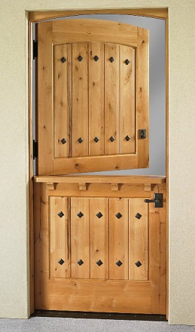
Design Principle
The Open-Closed Principle
Classes should be open for extension, but closed for modification.
Using composition to extend the behaviour of objects
New functionality can be added by writing new code rather than modifying existing code
Not altering existing code reduces the chances of introducing bugs and causing unintended side effects in pre-existing code

Slide 12
Decorator Pattern
The decorator pattern attaches additional responsibilities to an object dynamically. Decorators provide a flexible alternative to sub-classing for extending functionality.

Slide 13
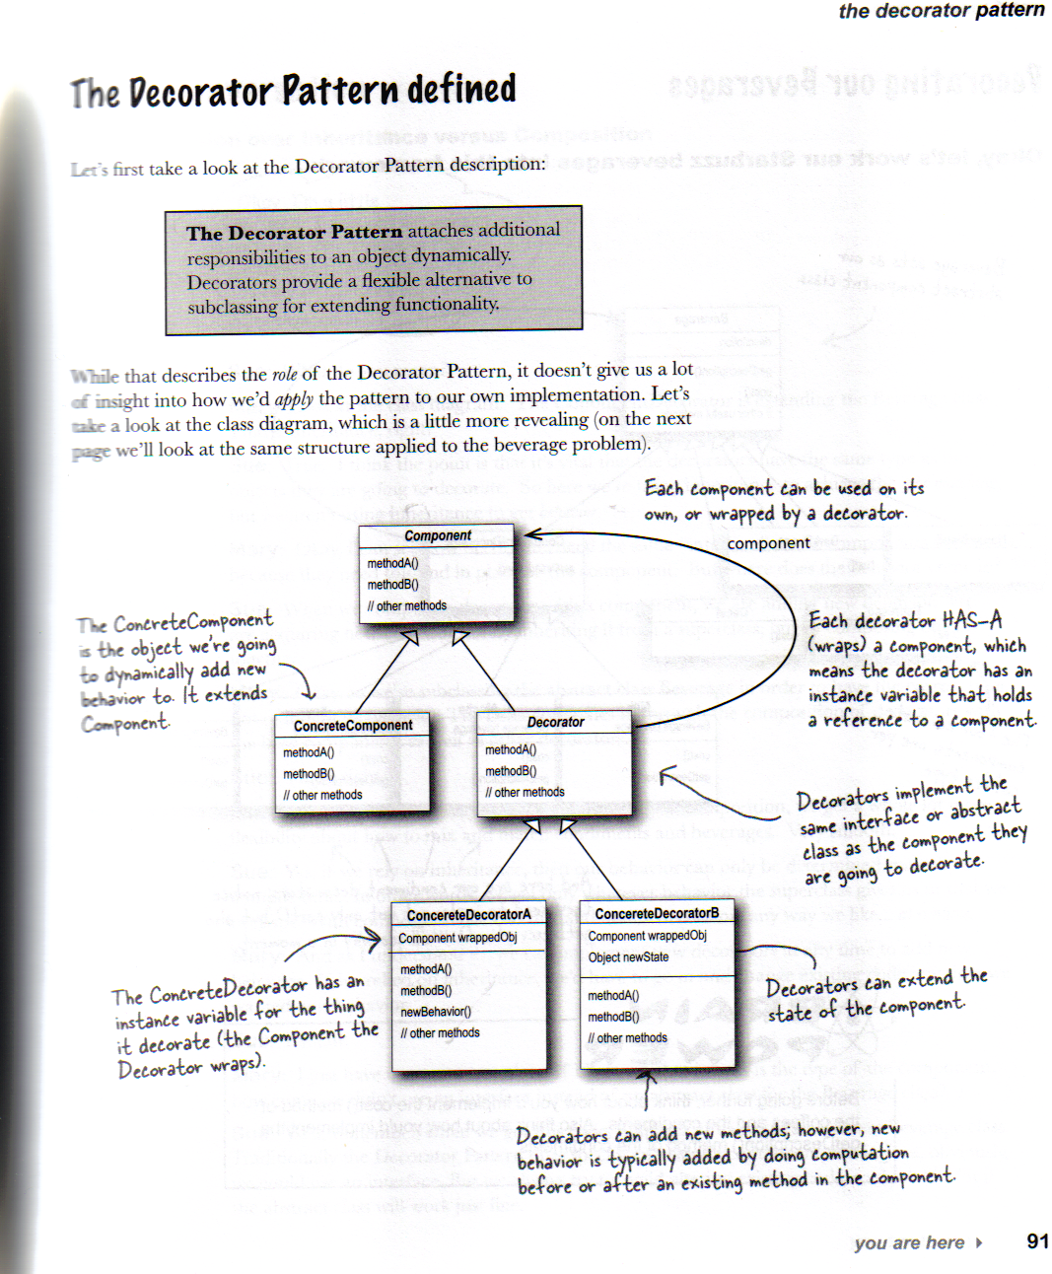
Decorator Pattern Defined
Decorator Pattern Defined
Page 91
Head First
Design Patterns

Slide 19
Espresso $1.99

Slide 20
Espresso $1.99
Dark Roast Coffee, Mocha, Mocha, Whip $1.49

Slide 21
Espresso $1.99
Dark Roast Coffee, Mocha, Mocha, Whip $1.49
House Blend Coffee, Soy, Mocha, Whip $1.34

Slide 22
Do we have to have this?

Slide 23
Decorator Pattern
Attach additional responsibilities to an object dynamically. Decorators provide a flexible alternative to subclassing for extending functionality.
Decorators are alternatives to subclassing. Subclassing adds behaviour at compile time whereas decorators provide a new behaviour at runtime.

Slide 24
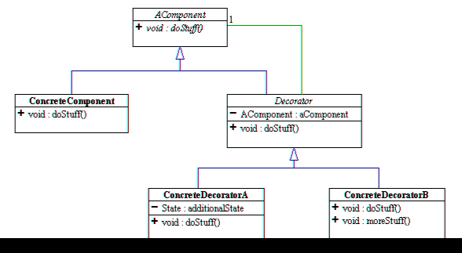
Type matching
NOT
get behaviours
void doStuff(){
aComponent.doStuff();
//maybe more stuff
}

Slide 25
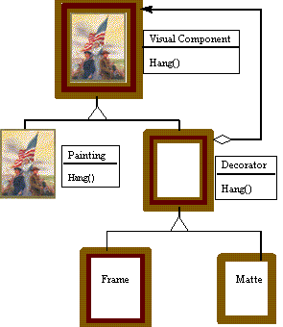
aVisualComponent

Slide 26
A look at Java GUI classes
Java I/O uses a lot of decorator pattern

Slide 27
Java I/O Use of Decorator Pattern
LineNumberInputStream
BufferedInputStream
FileInputStream

Slide 28
Decorating Java I/O Classes
Abstract component
InputStream
These InputStreams act as concrete components, to be wrapped with decorators
FilterInputStream is an ‘abstract’ decorator
FileInputStream
ByteArrayInputStream
StringBufferInputStream
FilterInputStream
LineNumberInputStream
PushBackInputStream
Concrete decorators
DataInputStream
Ablity to count line numbers as it reads data
BufferedInputStream
Buffers input for performance
Methods readLine(), mark(), reset()

Slide 29
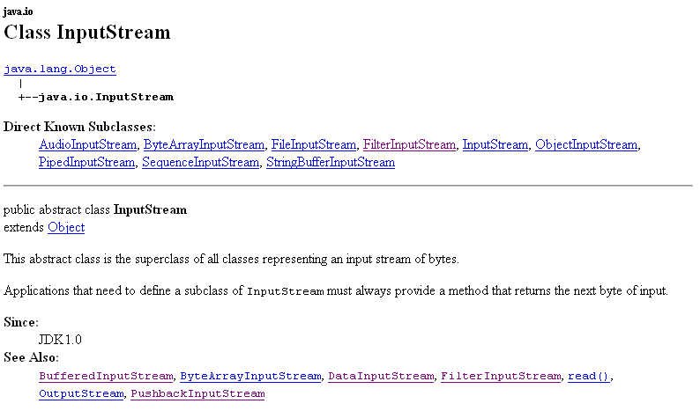

Slide 30
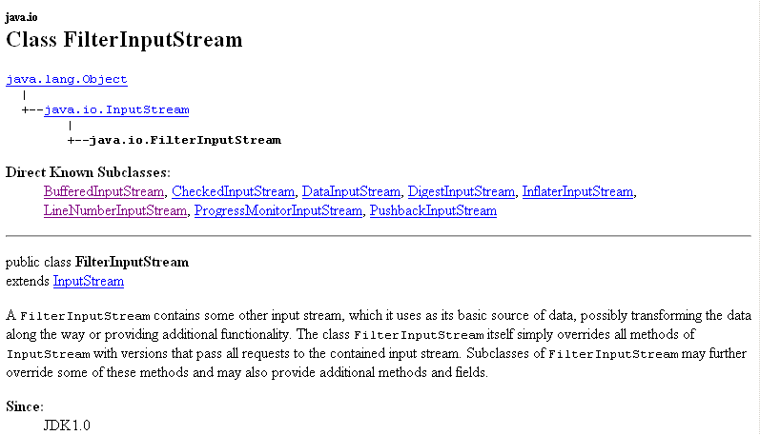

Slide 31
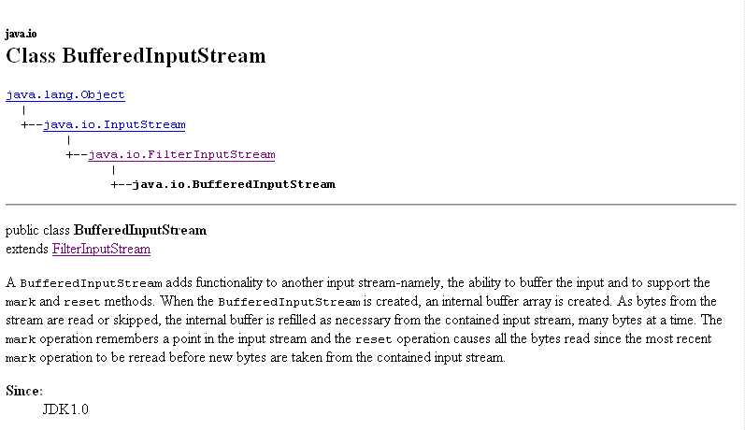

Slide 32
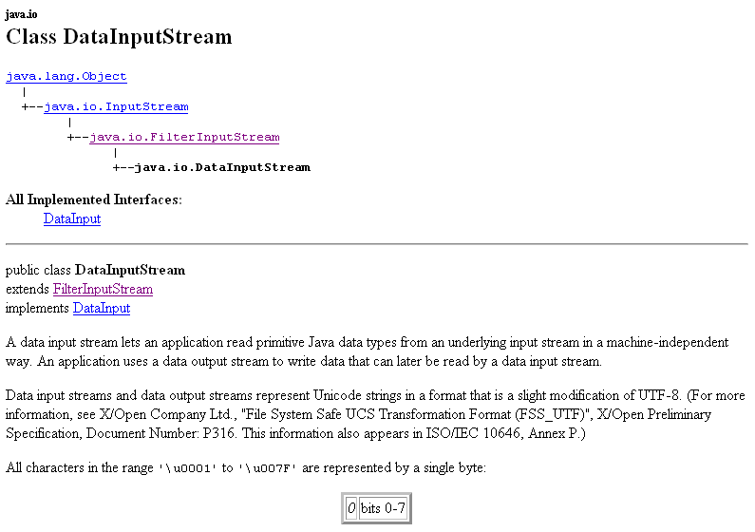

Slide 33
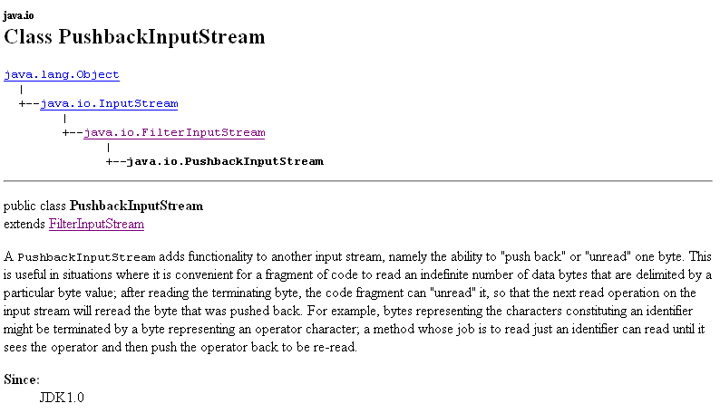

Slide 34
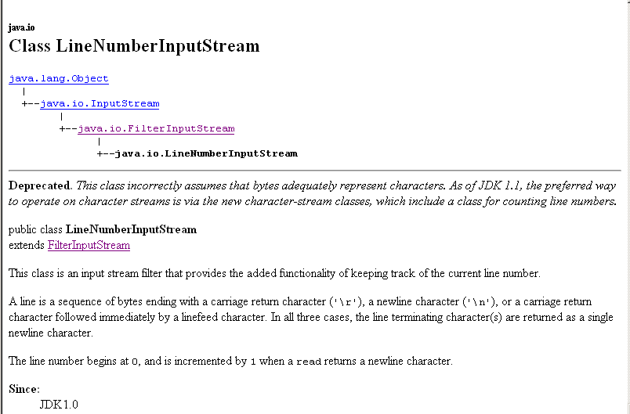

Slide 35
Writing your own Java I/O decorator
We have learned the decorator pattern
And I/O class diagram
Write a decorator that converts all uppercase characters to lowercase characters in the input stream

Slide 36
Extend the FilterInputStream, the abstract decorator for all inputStream
import java.io.*;
public class LowerCaseInputStream extends FilterInputStream {
public LowerCaseInputStream(InputStream in) {
super(in);
}
public int read() throws IOException {
int c = super.read();
return (c == -1 ? c : Character.toLowerCase((char)c));
}
public int read(byte[] b, int offset, int len) throws IOException {
int result = super.read(b, offset, len);
for (int i = offset; i < offset+result; i++) {
b[i] = (byte)Character.toLowerCase((char)b[i]);
}
return result;
}
}
Implement 2 read() methods, taking a byte (or an array of bytes) and convert each byte to lowercase if it is an uppercase character

Slide 37
import java.io.*;
public class InputTest {
public static void main(String[] args) throws IOException {
int c;
try {
InputStream in =
new LowerCaseInputStream(
new BufferedInputStream(
new FileInputStream("test.txt")));
while((c = in.read()) >= 0) {
System.out.print((char)c);
}
in.close();
} catch (IOException e) {
e.printStackTrace();
}
}
}
Set up fileInputStream and decorate it, first with BufferedInputSteam and then LowercaseInputStream filter.

Slide 38
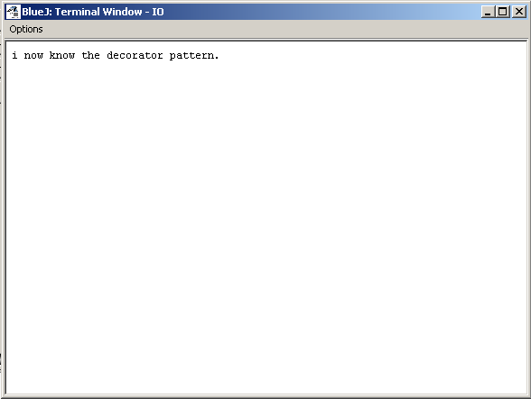
Executing project IO
Test.txt contains “I now know the DECORATOR PATTERN.”

Slide 39
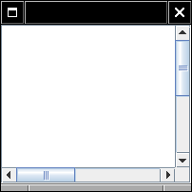
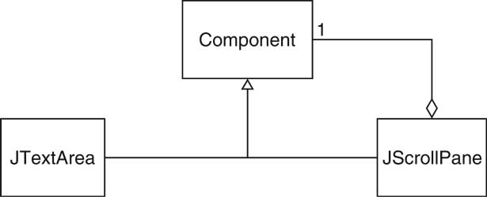
Real world scenario
A JScrollPane with JTextArea
JTextArea area = new TextArea(10,25);
JScrollPane areaScrollPane = new JScrollPane(area);

Slide 40
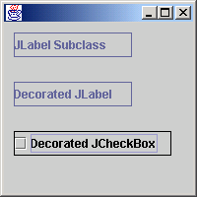
Extension by subclassing
public class JBorderLabel extends JLabel {
public JBorderLabel() { super(); }
public JBorderLabel(String text) { super(text); }
public JBorderLabel(Icon image) { super(image); }
public JBorderLabel(String text, Icon image, int horizontalAlignment) {
super(text, image, horizontalAlignment);
}
public JBorderLabel(String text, int horizontalAlignment) {
super(text, horizontalAlignment);
}
protected void paintComponent(Graphics g) {
super.paintComponent(g);
int height = this.getHeight();
int width = this.getWidth();
g.drawRect(0, 0, width - 1, height - 1);
}
}

Slide 41
Extension by decorator
public class BorderDecorator extends JComponent {
// decorated component
protected JComponent child;
public BorderDecorator(JComponent component) {
child = component;
this.setLayout(new BorderLayout());
this.add(child);
}
public void paint(Graphics g) {
super.paint(g);
int height = this.getHeight();
int width = this.getWidth();
g.drawRect(0, 0, width - 1, height - 1);
}
}

Slide 42
Use Decorator Border
JBorderLabel label1 = new JBorderLabel("JLabel Subclass");
BorderDecorator label2 = new BorderDecorator(
new JLabel("Decorated JLabel"));
BorderDecorator checkBox1 = new BorderDecorator(
new JCheckBox("Decorated JCheckBox"));

Slide 43
Window with scrolling bar
// the Window interface
interface Window {
public void draw(); // draws the Window
public String getDescription(); // returns a description of the Window
}
// implementation of a simple Window without any scrollbars
class SimpleWindow implements Window {
public void draw() {
// draw window
}
public String getDescription() {
return "simple window";
}
}

Slide 44
Abstractor decorator class
// Note that it implements Window
abstract class WindowDecorator implements Window {
protected Window decoratedWindow;
// the Window being decorated
public WindowDecorator (Window decoratedWindow) {
this.decoratedWindow = decoratedWindow;
}
}

Slide 45
Decorator to add vertical scrollbar
// the first concrete decorator which adds vertical scrollbar functionality
class VerticalScrollBarDecorator extends WindowDecorator {
public VerticalScrollBarDecorator (Window decoratedWindow) {
super(decoratedWindow);
}
public void draw() {
drawVerticalScrollBar();
decoratedWindow.draw();
}
private void drawVerticalScrollBar() {
// draw the vertical scrollbar
}
public String getDescription() {
return decoratedWindow.getDescription() + ", including vertical scrollbars";
}
}

Slide 46
Decorator to add horizontal scrollbar
// the second concrete decorator which adds horizontal scrollbar functionality
class HorizontalScrollBarDecorator extends WindowDecorator {
public HorizontalScrollBarDecorator (Window decoratedWindow) {
super(decoratedWindow);
}
public void draw() {
drawHorizontalScrollBar();
decoratedWindow.draw();
}
private void drawHorizontalScrollBar() {
// draw the horizontal scrollbar
}
public String getDescription() {
return decoratedWindow.getDescription() + ", including horizontal scrollbars";
}
}

Slide 47
Test class
public class DecoratedWindowTest {
public static void main(String[] args) {
// create a decorated Window with
// horizontal and vertical scrollbars
Window simpleWindow = new SimpleWindow();
Window verticalScrollBarWindow = new verticalScrollBarDecorator(simpleWindow);
Window decoratedWindow = new HorizontalScrollBarDecorator (verticalScrollBarWindow);
// print the Window's description
System.out.println(decoratedWindow.getDescription());
}
}

Slide 48
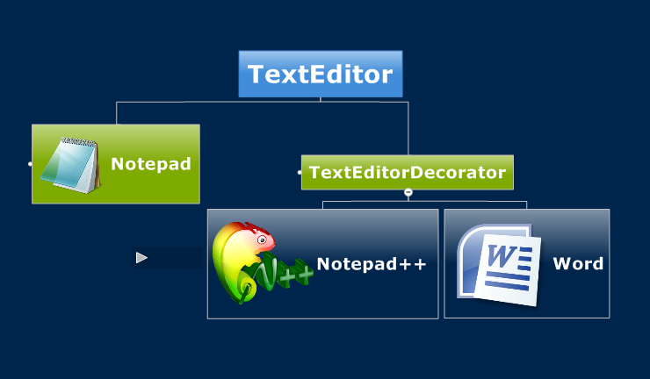

Slide 49
The TextEditor interface.
package net.searchdaily.java.design.pattern.decorator;
/**
* Decorator Pattern Tutorial by http://java.searchdaily.net.
*
* @author namnvhue
*
*/
public interface TextEditor {
public String create(); // create text file
public String edit(); // edit the file
public String save(); // save the change to hard disk
}

Slide 50
package net.searchdaily.java.design.pattern.decorator;
/**
* Decorator Pattern Tutorial by http://java.searchdaily.net.
*
* @author namnvhue
*
*/
public abstract class TextEditorDecorator implements TextEditor {
protected TextEditor enhancedTextEditor; // will support more features later
public TextEditorDecorator(TextEditor textEditor) {
this.enhancedTextEditor = textEditor;
}
@Override
public String create() {
return this.enhancedTextEditor.create();
}
@Override
public String edit() {
return this.enhancedTextEditor.edit();
}
@Override
public String save() {
return this.enhancedTextEditor.save();
}
}

Slide 51
Notepad: The first concrete implementation
package net.searchdaily.java.design.pattern.decorator;
/**
* Decorator Pattern Tutorial by http://java.searchdaily.net.
*
* @author namnvhue
*
*/
public class Notepad implements TextEditor { // The most basic text editor in
// the world.
@Override
public String create() {
return "Notepad is Creating";
}
@Override
public String edit() {
return "Notepad is Editing";
}
@Override
public String save() {
return "Notepad is Saving";
}
}

Slide 52
Notepad++ wraps a simple text editor inside and then add more features to it.
package net.searchdaily.java.design.pattern.decorator;
/**
* Decorator Pattern Tutorial by http://java.searchdaily.net.
*
* @author namnvhue
*
*/
public class NotepadPlusPlus extends TextEditorDecorator {
public NotepadPlusPlus(TextEditor textEditor) {
super(textEditor);
}
public String edit() { // we enhance the method edit of Notepad
return this.enhancedTextEditor.edit() + this.supportFormat()
+ this.supportFolding();
}
private String supportFormat() {
return " with Text Format";
}
private String supportFolding() {
return " and Block Folding supported";
}
}

Slide 53
Word with even more supports
package net.searchdaily.java.design.pattern.decorator;
/**
* Decorator Pattern Tutorial by http://java.searchdaily.net.
*
* @author namnvhue
*
*/
public class Word extends TextEditorDecorator {
public Word(TextEditor textEditor) {
super(textEditor);
}
public String edit() {
StringBuilder sb = new StringBuilder();
sb.append(this.enhancedTextEditor.edit() + " with more features:n");
for (String feature : this.supportFeatures()) {
sb.append(" * " + feature + "n");
}
return sb.toString();
}
private String[] supportFeatures() {
String[] wordFeatures = { "RichText", "Image", "Table", "WordArt",
"ClipArt", "And many more..." };
return wordFeatures;
}
}

Slide 54
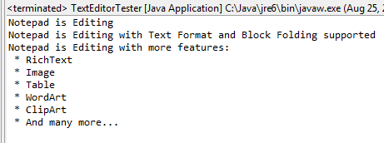
Tester class
package net.searchdaily.java.design.pattern.decorator;
/**
* Decorator Pattern Tutorial by http://java.searchdaily.net.
*
* @author namnvhue
*
*/
public class TextEditorTester {
/**
* @param args
*/
public static void main(String[] args) {
// First we will create a very basic text editor: the Notepad
Notepad basicTextEditor = new Notepad();
// See how notepad edits
System.out.println(basicTextEditor.edit());
// Now we will enhance that notepad to notepad++
NotepadPlusPlus notepadPlus = new NotepadPlusPlus(basicTextEditor);
// Let's see how notepad++ can edit
System.out.println(notepadPlus.edit());
//Finally we will examine the Word editor
Word word = new Word(basicTextEditor);
System.out.println(word.edit());
}
}

Slide 55
Adapter vs Decorator
Adapter provides a different interface to its subject.
Decorator provides an enhanced interface.

Slide 56
Problem Domain
Employees are working with different responsibilities (such as team members, team leads and a manager).
A team member is responsible to do his assigned tasks and to coordinate with other members for the completion of group tasks.
A team lead has to manage and collaborate with his team members and plan their tasks.
A manager has some extra responsibility over a team lead such as employee profiling, work assignment.

Slide 57
Employee: calculate salary, join, terminate.
Team member: perform task, coordinate with others.
Team lead: planning, motivate.
Manager: assign task, employee profiling, create requirements.

Slide 58
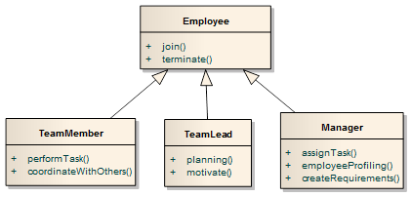
Traditional Approach

Slide 59
Problems with traditional approach
Whenever a team member becomes a team lead, or when an employee turns into a manager from a team lead/team member.
Temporary fix:
we have to create a new object of team lead and the previous object that points to that employee (team member) may be destroyed or archived. That’s not a recommended approach when employee is still a part of your organization.
An employee can perform responsibilities of a team member as well as those of a team lead or a manager can perform team leads responsibilities.
Temporary fix:
You need to create two objects for the same employee which is totally wrong.
In these scenarios a team member/team lead can have extra responsibilities at run time. And their responsibilities can be assigned/revoked at run time.

Slide 60
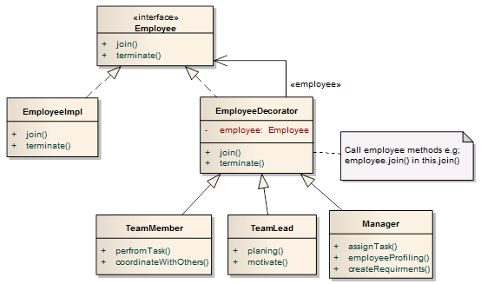
Decorator Pattern Approach Attach additional responsibilities to an object dynamically.

Slide 61
Employee (Decorated/Component)
public interface Employee { public void join(Date joinDate); public void terminate(Date terminateDate); // other behaviors may reside (see sample code)
}

Slide 62
EmployeeImpl
public class EmployeeImpl implements Employee { // other behaviors and properties may reside (see sample code) public void join(Date joinDate){ print(this.getName() + ” joined on “ + joinDate); } public void terminate(Date terminateDate){ print(this.getName() + ” terminate on “ + terminateDate); }
}

Slide 63
EmployeeDecorator (Abstract Decorator)
public abstract class EmployeeDecorator implements Employee { protected Employee employee; protected EmployeeDecorator(Employee employee) { this.employee = employee; } // other behaviors may reside (see sample code) public void join(Date joinDate) { employee.join(joinDate); } public void terminate(Date terminateDate) { employee.terminate(terminateDate); } }

Slide 64
TeamMember (Concrete Decorator)
public class TeamMember extends EmployeeDecorator { protected TeamMember(Employee employee) { super(employee); } public void performTask() { print(employee.getName() + ” is performing his assigned tasks.”); } public void coordinateWithOthers() { print(employee.getName() + ” is coordinating with other members of his team.”); } }

Slide 65
TeamLead (Concrete Decorator)
public class TeamLead extends EmployeeDecorator { protected TeamLead(Employee employee) { super(employee); } public void planing() { print(this.employee.getName() + ” is planing.”); } public void motivate() { print(this.employee.getName() + ” is motivating his members.”); } }

Slide 66
Manager (Concrete Decorator)
public class Manager extends EmployeeDecorator { protected Manager(Employee employee) { super(employee); } public void assignTask() { print(this.employee.getName() + ” is assigning tasks.”); } public void profileEmployee() { print(this.employee.getName() + ” is profiling employees.”); } public void createRequirments() { print(this.employee.getName() + ” is creating requirement documents.”); } }

Slide 67
An Evaluation Application
Let’s consider a program where there are some rules that will be used in evaluating an application submitted to a University.
Say the Registrar object, in our program, is responsible for carrying out the specific evaluation by using the rules.
To start with say we only have been given the GPAEval as the criteria to be applied.

Slide 68
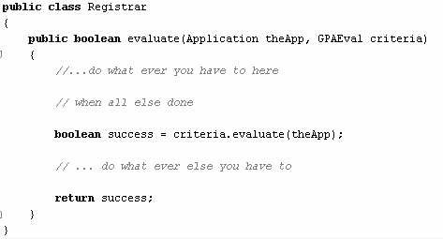
Registrar class

Slide 69
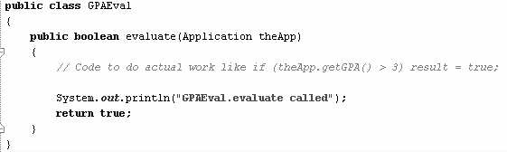
GPAEval class

Slide 70
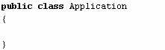
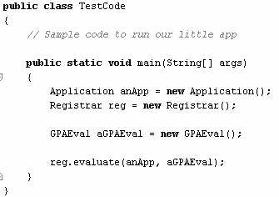

Application and Test code class

Slide 71
Let’s Extend this now
In some but not all cases, evaluate GRE scores in addition to GPA scores. How can we realize this without breaking the Registrar class?

Slide 72
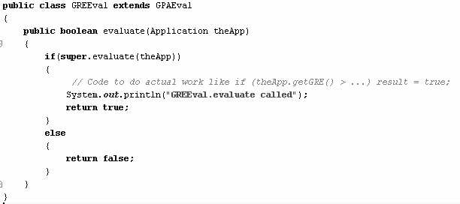
One possibility is to derive from the GPAEval class

Slide 73

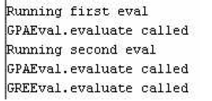
Test code class

Slide 74
Now what?
Now, we are asked to evaluate the applicant based on TOEFL and GPA.
How can we do that? We can write another class TOEFLEval which inherits from GPAEval and that should take care of it right?

Slide 75
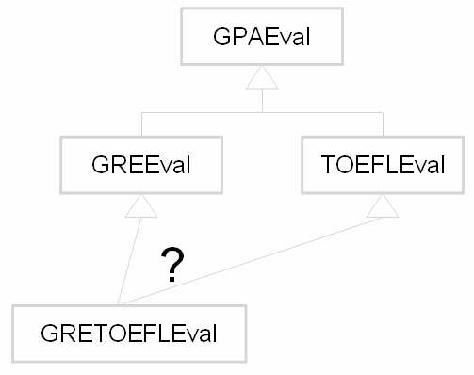
Growing Pain
Some need two of them
Some need all GPA, GRE, TOEFL

Slide 76
Who comes to rescue?
Decorator is a pattern that shows us how to solve problems like this.
Another way to understand decorator is to understand chaining.
The criteria objects can be chained to achieve extensibility and agility

Slide 77
Decorator in action
I wake up on Tuesday morning to teach my favorite cosc 330 and I look in the mirror and say “you do not look good.”
May take shower
May wear a nice shirt and pant
May wear a tie, a tie pin, etc
May wear a makeup
Or ear rings, nose rings, tongue rings, etc!
In other words, we decorate the object with other objects.

Slide 78
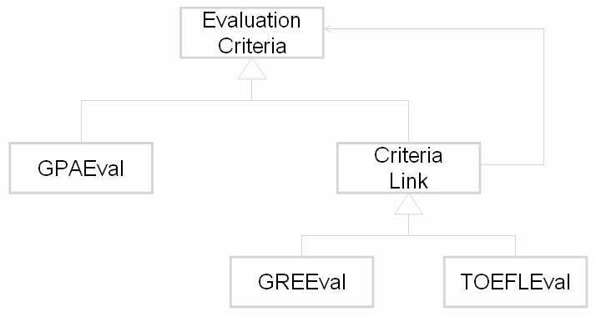
Decorator Pattern Solution

Slide 79
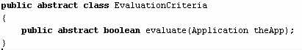
abstract class EvaluationCriteria

Slide 80
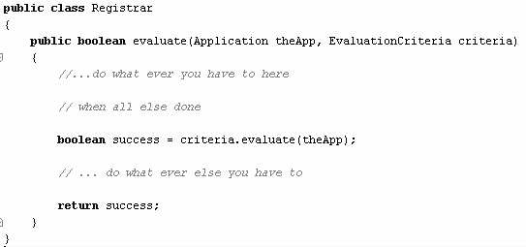
Registrar class

Slide 81
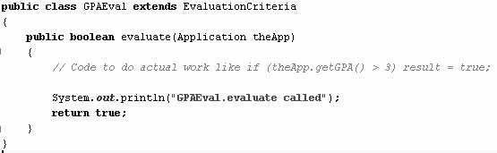
GPAEval derived from EvaluationCriteria

Slide 82
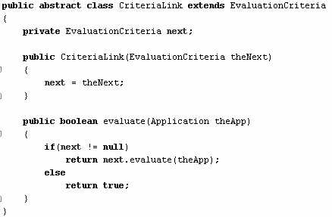
CriteriaLink class

Slide 83
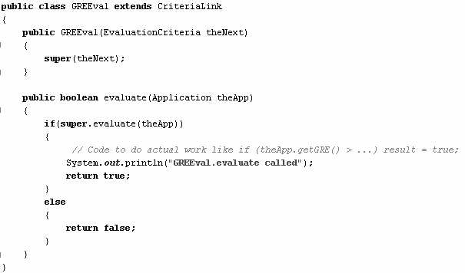
GREEval class

Slide 84
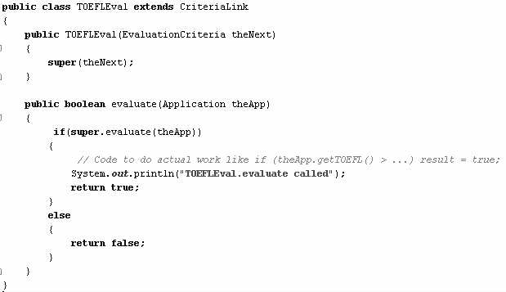
TOEFLEval class

Slide 85
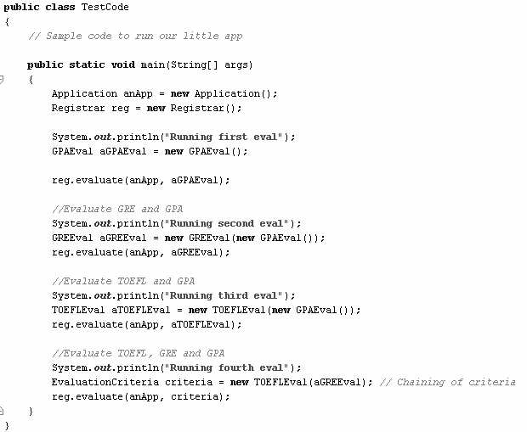


Slide 86
Summary so far..
OO Basics
Abstraction
Encapsulation
Inheritance
Polymorphism
OO Principles
Encapsulate what varies
Favor composition over inheritance
Program to interfaces not to implementations
Strive for loosely coupled designs between objects that interact
Classes should be open for extension but closed for modification.
OO Patterns
Strategy Pattern defines a family of algorithms, Encapsulates each one, and makes them interchangeable. Strategy lets the algorithm vary independently from clients that use it.
Observer Pattern defines a one-to-many dependency between objects so that when one object changes state, all of its dependents are notified and updated automatically.
Decorator Pattern – attach additional responsibilities to an object dynamically. Decorators provide a flexible alternative for sub-classing for extending functionality

Slide 87
Basing it off a different abstract class exposes this design aspect
and makes it clearer how new decorations are to be added.
Implementing the decorations as child classes blurs this distinction and
leaves the implementation open to child classes that may break the
decoration pattern unwittingly.
Omitting the abstract Decorator class. There's no need to define an abstract
Decorator class when you only need to add one responsibility.

